Slide 1


High Throughput Sequencing and applications
Lex Nederbragt
Norwegian High-Throughput Sequencing Centre (NSC)
and
Centre for Ecological and Evolutionary Synthesis (CEES)

Slide 2
* Illumina HiSeq 1000 1500 2000 2500 3000 4000
* Illumina HiSeq X (Five and Ten)
* Illumina NextSeq 500
* Illumina MiSeq
* Illumina MiniSeq
* Pacific Biosciences RSII
* Pacific Biosciences Sequel
* Ion Torrent PGM
* Ion Torrent Proton
* Ion Torrent S5 and S5XL
* Oxford Nanopore MinION (MkI)
* Oxford Nanopore PromethION
* SOLiD 1 2 3 4 5500 5500XL
* BGISEQ-500
* ABI Sanger 3730xl
Obsolete:
* Roche 454 GS FLX, Junior
* HeliScope

Slide 3
Special types
* 10X genomics
* Dovetail Genomics
* Moleculo/TruSeq synthetic reads
* BioNano Genomics

Slide 4
Read lengths versus throughput
for each sequencing instrument still being sold, find the specifications on the company’s website
make a plot in a google spreadsheet with the read length on the x-axis and the per-run throughput in Gigabp on the Y axis
make both axis log scale
Decide for yourself what to take as length and throughput – but be able to defend your choices

Slide 5
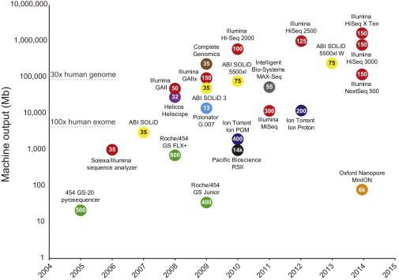
Reuter et al (2015): http://dx.doi.org/10.1016/j.molcel.2015.05.004

Slide 6
Pacific Biosciences
Zero-mode waveguide
Metzker 2010 Nat Rev Genet.11(1):31-46

Slide 7
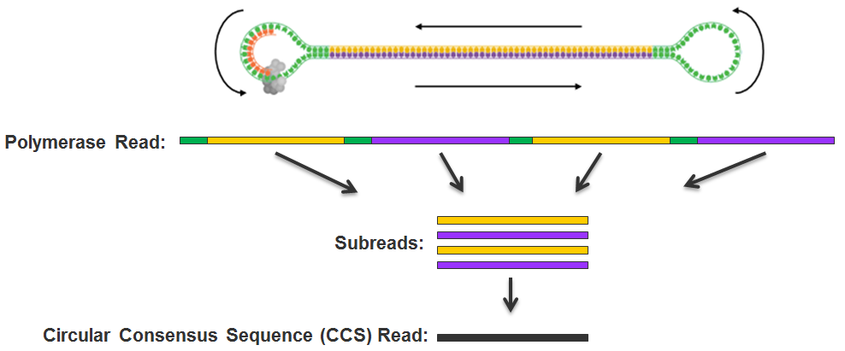
PacBio SMRTBell
http://files.pacb.com/software/smrtanalysis/2.2.0/doc/smrtportal/help/!SSL!/Webhelp/Portal_PacBio_Glossary.htm

Slide 8
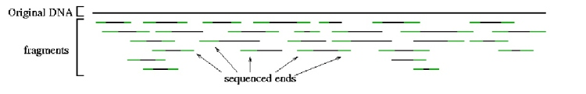

Single end, paired end mate pairs
Paired end reads → 100-500 bp insert
original DNA
fragments
Sequenced ends
Mate pairs → 2-20 kb insert
Repeat copy 1
Repeat copy 2
mate pair reads

Slide 9
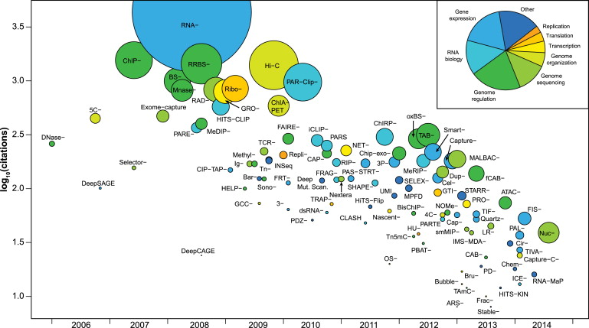
Reuter et al (2015): http://dx.doi.org/10.1016/j.molcel.2015.05.004

Slide 10
HTS data analysis

Slide 11
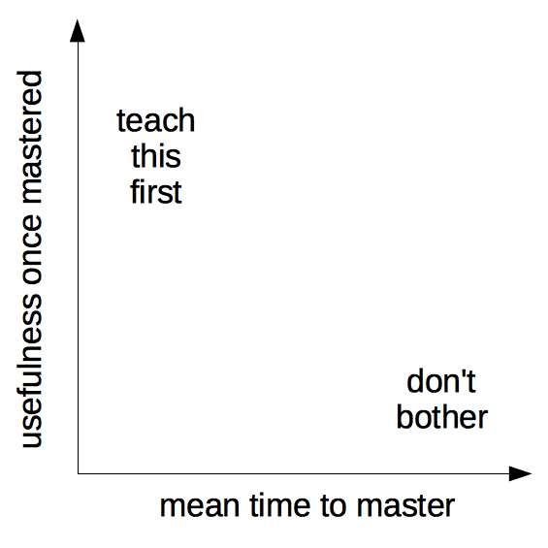

Slide 12
Data
Amount of data
Finding data
Getting data in the right shape
Scrubbing
Understanding the data
Data management
Sharing data

Slide 13
Software
Understanding the algorithms
Installing software
Choosing program from all possible
Can not always use the same tool
Not always the same tool that is best
Software parameter space
Validation of computational results

Slide 14
Compute resources
Local versus HPC versus cloud
Computational time
Getting access
Optimal use of HPC resources

Slide 15
User interfaces
unix shell
web-based
GUI-based

Slide 16
Skills
Unix skills
Programming skills
Statistics

Slide 17
Ethics
Ethical approval
Sensitive data
Reproducibility

Slide 18
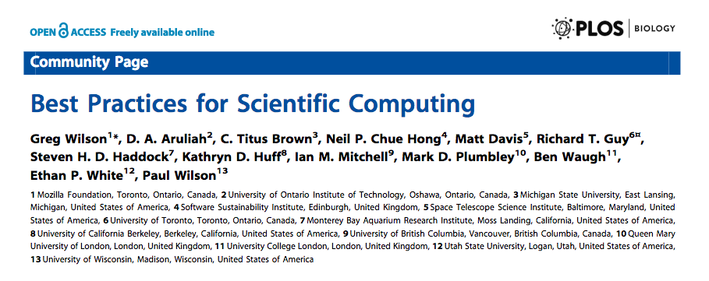
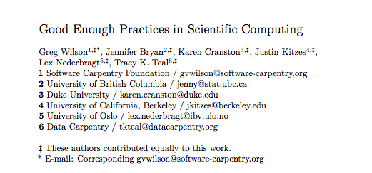
Best/good-enough practices
doi: 10.1371/journal.pbio.1001745
https://arxiv.org/abs/1609.00037

Slide 19
Skills

Slide 20
Aim
Provide the student with a good conceptual and technical foundation for using HTS data to answer bio-medical questions

Slide 21
Fields
Biological concepts
DNA, RNA, protein, reference genome, mutations/variation, gene expression, etc
Sequencing technology
Statistical and informatic concepts

Slide 22

Subjects
Common concepts?
Genome assembly
Gene expression
Variant calling
Statistical genomics

Slide 23
Technical / bioinformatic
Study design
Mapping principles
Alignment principles
Alternative splicing
Model system vs non-model system organisms

Slide 24
The practice of bioinformatics / computational biology
Transparency/reproducibility
Data management
Statistics and hypothesis testing
Summary statistics and visualization
Sanity checking / validation of results
Finding data and munging it (incl. public databases)

Slide 25
QC of sequencing reads

Slide 26
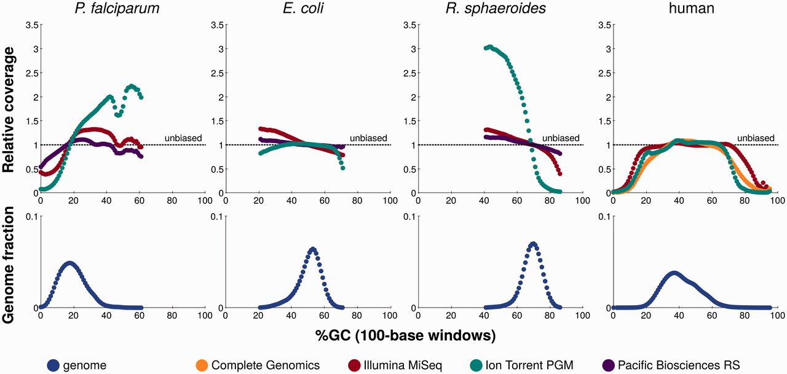
GC bias
Laehnemann et al 2015 () http://bib.oxfordjournals.org/content/early/2015/05/29/bib.bbv029
(after http://www.genomebiology.com/content/14/5/R51)

Slide 27
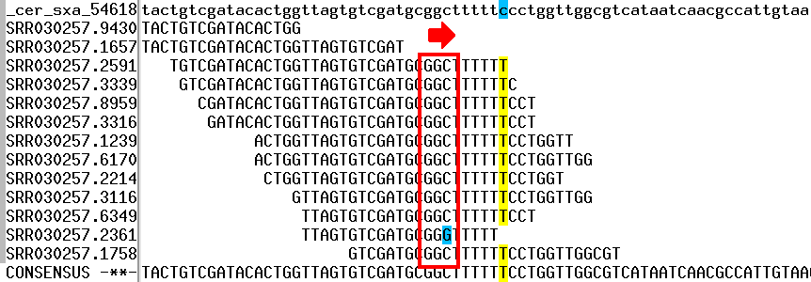
GGCxG motifs and Illumina
Reference
http://mira-assembler.sourceforge.net/docs/DefinitiveGuideToMIRA.html

Slide 28
Project organisation

Slide 29
“
Someone unfamiliar with your project should be able to look at your computer files and understand in detail what you did and why
”
Noble (2009) http://dx.doi.org/10.1371/journal.pcbi.1000424

Slide 30
“
Everything you do,
you will probably have to do over again
”
Noble (2009) http://dx.doi.org/10.1371/journal.pcbi.1000424

Slide 31
“
Your most important collaborator is
you, six months from now*
”
*… and you six months ago
does not answer email

Slide 32
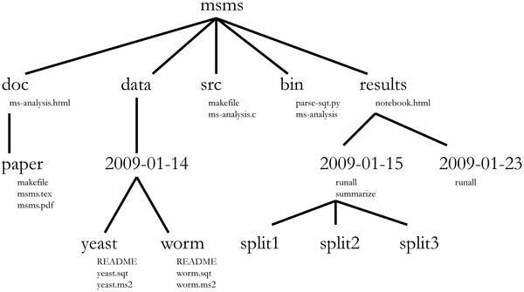
Noble (2009) http://dx.doi.org/10.1371/journal.pcbi.1000424

